Slide 1


MUSIC RECOMMENDATION SYSTEM
FOR
Meditation & Relaxation Music Playlist
Group 3
Team members : Chetan Kumar
Ruksana
Ashish Ponde
Adarsh
Prathyush BR
Ragavendra Savant
Yash Pednekar
Mentor : M.S Neha
Date : 12-03-2022

Slide 2

Problem Statement
Build a music recommendation system which recommends meditation and relaxation type music or songs to listeners based on information on users behaviour, activities or preferences and predicting what users will like based on there similarity to other users.

Slide 3
Introduction
With the rise of digital content distribution, we have access to a huge music collection. With millions of songs to choose from, we sometimes feel overwhelmed. Thus, an efficient music recommender system is necessary in the interest of both music service providers and customers
Our music recommender system is large-scale and personalized. We learn from users’ listening history and features of songs and predict songs that a user would like to listen to recommender system is necessary in the interest of both music service providers and customers

Slide 4

Project Workflow
Data Set
Preprocessing the data set(EDA)
Model Building
Deployment

Slide 5
What is Recommendation System Recommendation systems are the systems that are designed to recommend things to the user based on many different factors. These systems predict the most likely product that the users are most likely to purchase and are of interest to. Companies like NETFLIX, Amazon, etc. use recommender systems to help their users to identify the correct product or movies for them.

Slide 6

Why the Recommendation system?
Benefits users in finding items of their interest.
Help item providers in delivering their items to the right user.
Identity products that are most relevant to users.
Personalized content.
Help websites to improve user engagement.

Slide 7
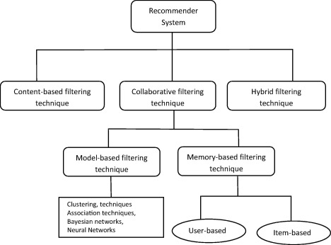
Types of Recommendations Systems

Slide 8
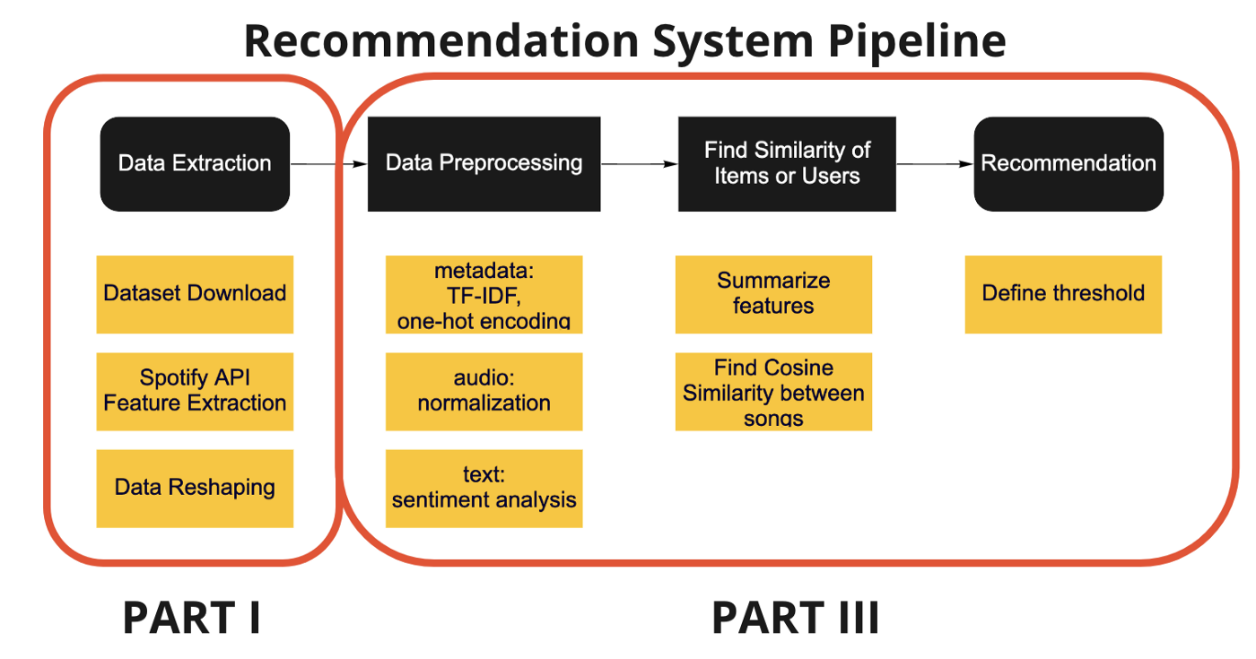
Implementation

Slide 9

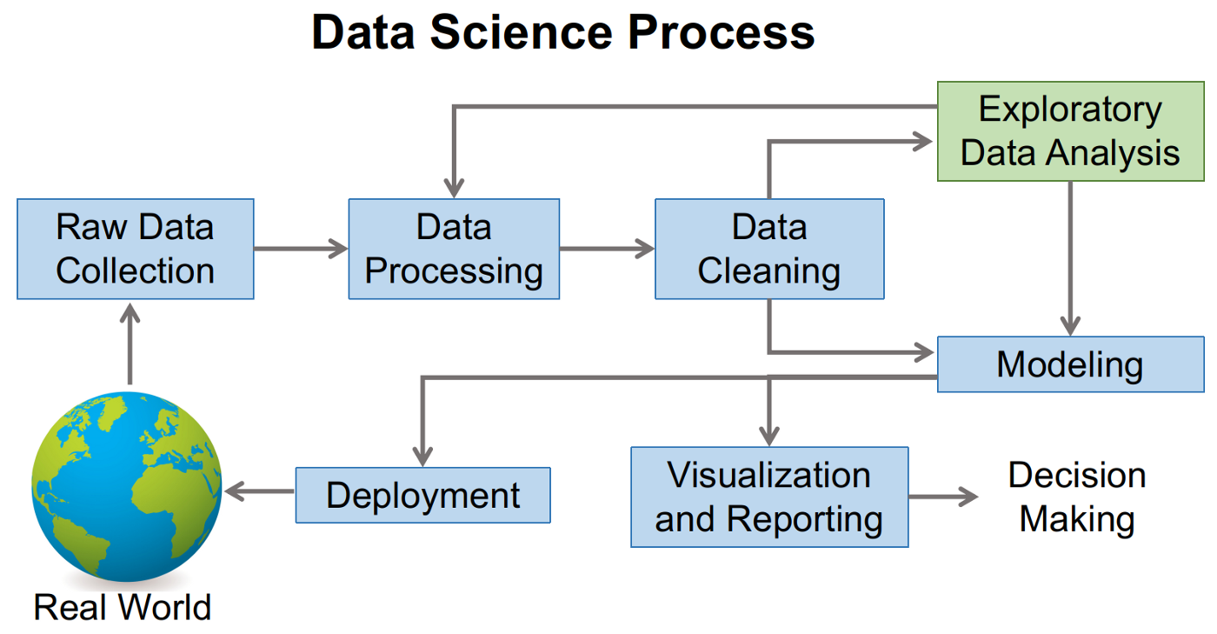
Large image
WORKING MODEL OF MODEL BULIDING

Slide 10
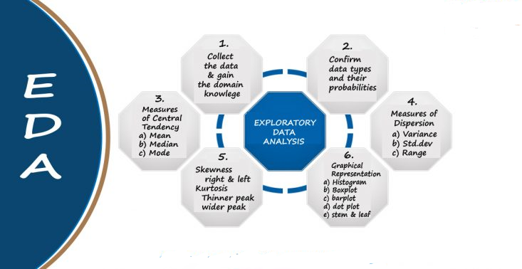
Understanding of Exploratory Data Analysis

Slide 11
Deployment
Deployment is the mechanism through which applications, modules, updates, and patches are delivered from developers to users.
The methods used by developers to build, test and deploy new code will impact how fast a product can respond to changes in customer preferences or requirements and the quality of each change.
Streamlit is an app framework to deploy machine learning apps built using Python. you can immediately deploy your project using Streamlit Sharing

Slide 12
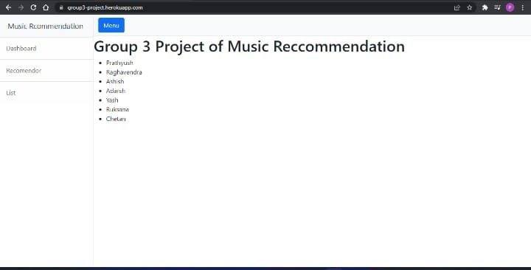
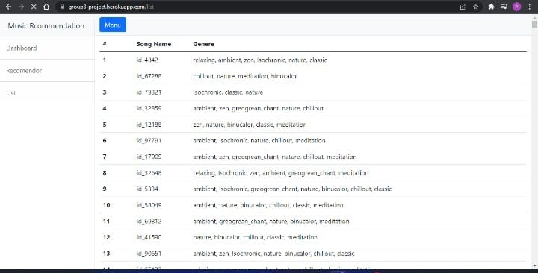
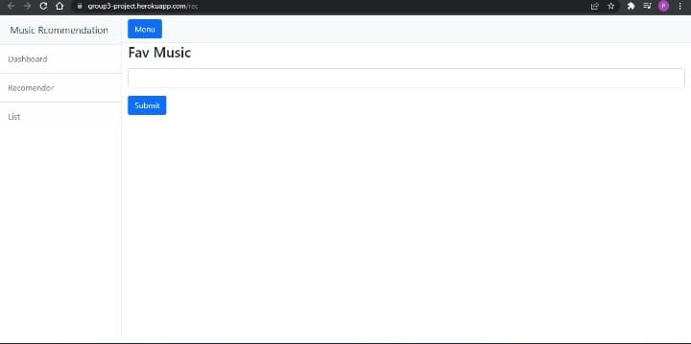
OUTPUT DISPLAY

Slide 13
PROJECT’S FURTHER DEVEPLOMENT
Website can be hosted live.
Using advancements of Deep-learning ML & NLP concept we can Recommend songs to user based on the keywords of their previously search

Slide 14


